Slide 1
Perfect Packaging
By Gregory Dowling

Slide 2
Goals and Objectives
Goal
Student will learn to determine optimum surface are and percent waste.
Objectives
Work with a partner to determine the dimensions, volume and surface area of two containers
Determine the minimum surface are of a shape given a constant volume.
Compare and contrast optimized containers with actual containers.
Determine precept waste in actual containers as compared to the optimum container.

Slide 3
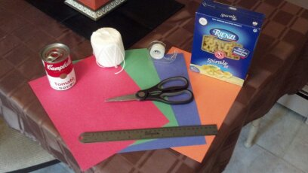
What you will need:
Two (2) regularly shaped products (cereal box, shoe box, soup can, etc.)
Centimeter ruler
String (If one product is a soup can)
Scissors
Construction paper
Tape

Slide 4
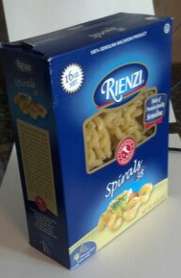
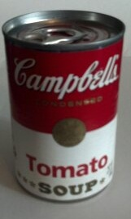
Measurements- use centimeter ruler to measure the dimensions on both objects to the nearest half centimeter
Box - box of Spaghetti
Can – soup can
Length: 14.5 cm
Width: 5.5 cm
Height: 19 cm
Circumference: 20.5 cm
Radius: = 3.26 cm
Height: 10 cm

Slide 5
Finding the Dimensions - Box
Volume of box:
V = l x w x h
Surface Area of box :
SA = 2(l x w) + 2(l x h) + 2(w x h)
Find the dimensions of the box in terms of the width
Width = w = 5.5 cm
Length = l = 14.5 cm = (14.5/5.5)w = (29/11)w
Height = h = 19 cm
V = l x w x h = 14.5 x 5.5 x 19 = 1515.25
1515.25 = l x w x h
1515.25 = (14.5/5.5)w x w x h
1515.25 = (14.5/5.5)w² x h
h = 1515.25/[(14.5/5.5)w²]

Slide 6
Finding the Dimensions- Can
Volume of can :
V = πr²h
Surface Area of can:
SA = 2πr² + 2πrh
Find the dimensions for the can in terms of the radius
Radius = r = 3.26 cm
V= πr²h = π(3.26)² x 10 = 106.28π = 333.88
333.88 = πr²h
h = 333.88/(πr²)

Slide 7
Finding the Formulas- Box
l = (29/11)w
h = 1515.25/ [(14.5/5.5)w²]
Create a new formula by replacing our new formulas for height and length into the formula
SA = 2(l x w) + 2(l x h) + 2(w x h)
SA = 2((29/11)w x w) +
2((29/11)w x 1515.25/ [(14.5/5.5)w²]) +
2(w x 1515.25/ [(14.5/5.5)w²])
SA = (58/11)w² + 3030.5/w+ 1149.5/w
SA = (58/11)w² + 3030.5/w

Slide 8
Finding the Formulas - Can
r = 3.26
h =
Repeat with the can but only subsitute for the height
SA = 2πr² + 2πrh
SA = 2πr² + 2πr( )
SA = 2πr² +

Slide 9
Optimizing the Surface Area-Box
Find the derivative of the new formula
SA = (58/11)w² + 3030.5/w
SA= (58/11)w² + 3030.5w⁻¹
SA’ = (116/11)w - 3030.5w⁻²
SA’ = (116/11)w - 3030.5/w²
Set the derivative equal to 0 and solve for w
0 = (116/11)w - 3030.5/w²
(116/11)w = 3030.5/w²
(116/11)w³ = 3030.5
w³ = 396.38
w= 3√396.38 = 7.35

Slide 10
Optimizing the Surface Area- Can
Find the derivative of the new formula
SA = 2πr² +
SA = 2 πr² + 667.76r⁻¹
SA’ = 4πr - 667.76r⁻²
SA’ = 4πr - 667.76/r²
Set the derivative equal to 0 and solve for r
0 = 4πr - 667.76/r²
4πr = 667.76/r²
4πr³ = 667.76
r³ = 53.14
r = cube root 53.14 = 3.76

Slide 11
Optimized Dimensions
Box - substitute the width
Can = substitute the radius
w = 7.35
l = (29/11)w = (29/11) 7.35
l = 19.37
h = 1515.25/[(14.5/5.5)w²]
h =1515.25/[(14.5/5.5)(7.35)²]
h = 10.64
r = 3.76
C = 2πr = 2π(3.76)
C = 23.62
h =

Slide 12
Optimized Surface Area
Box
Can

Slide 13
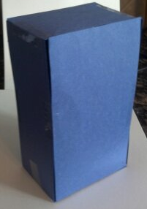
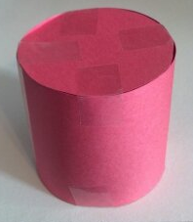
Building the New Shapes
Box
Can

Slide 14
Percent Waste
Box
Can
Actual SA – Optimum SA / Actual SA
Actual SA – Optimum SA / Actual SA

Slide 15
Follow-up Questions
What factors might lead a company to not want to use a box with an optimized surface area?
If every square centimeter of cardboard costs $0.001, how much would using the optimized surface area save the company in the first million products?

